Slide 1
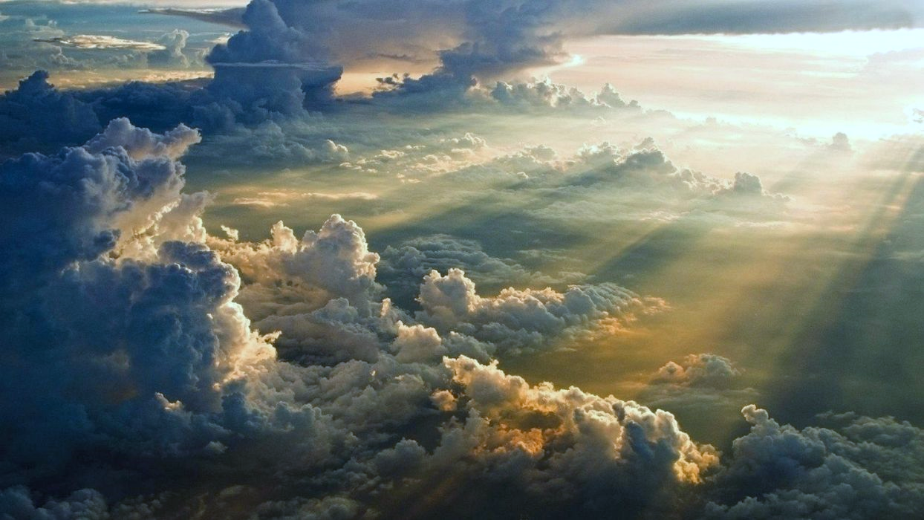
Colossians A glorious reminder of everything Christ did for us in conquering sin and death. It shows His supremacy over all things, explaining what our godly response should be.

Slide 2
Colossians 1: 15:20 Who is Jesus?
15 The Son is the image of the invisible God, the firstborn over all creation. 16 For in him all things were created: things in heaven and on earth, visible and invisible, whether thrones or powers or rulers or authorities; all things have been created through him and for him. 17 He is before all things, and in him all things hold together. 18 And he is the head of the body, the church; he is the beginning and the firstborn from among the dead, so that in everything he might have the supremacy. 19 For God was pleased to have all his fullness dwell in him, 20 and through him to reconcile to himself all things, whether things on earth or things in heaven, by making peace through his blood, shed on the cross.

Slide 3
1/5. Jesus is the image of the invisible God (15a)
He became the visible image of an invisible God (Manifestation)
Then God said, “Let us make man in our image, after our likeness. And let them have dominion over the fish of the sea and over the birds of the heavens and over the livestock and over all the earth and over every creeping thing that creeps on the earth.” Genesis 1:26

Slide 4
1/5 Jesus is the image of the invisible God (15a)
Jesus represented God perfectly (Representation).
That which was from the beginning, which we have heard, which we have seen with our eyes, which we looked upon and have touched with our hands, concerning the word of life … 1 John 1:1

Slide 5
1/5 Jesus is the image of the invisible God (15a)
He resembled God in all His qualities (Resemblance)
He is the radiance of the glory of God and the exact imprint of his nature, and he upholds the universe by the word of his power. After making purification for sins, he sat down at the right hand of the Majesty on high … Hebrews 1:3

Slide 6
1/5 Jesus is the image of the invisible God (15a)
More than visible, physical and resemblance, He interacted (Communication)
In the beginning was the Word, and the Word was with God, and the Word was God. … And the Word became flesh and dwelt among us, and we have seen his glory, glory as of the only Son from the Father, full of grace and truth. John 1:1,14

Slide 7
2/5 He is “the firstborn of all creation” (15b)
Refers to His position as supreme over all creation, not that He was created first.
Everything is beneath Jesus in value and glory, as in verse 16: “For by him all things were created … all things were created through him and for him.”
To put anything on the same level with Jesus is sin.

Slide 8
3/5 He “is before all things” (17)
Jesus takes precedent over all things both in status and in sequence.
He is the reason for all things, “and in him all things hold together.”
He is the core that all of reality orbits around.

Slide 9
4/5 “He is the head of the body, the church” (18a)
Jesus is the origin and the commander of the church.
The secret to getting a church to grow is
“holding fast to the Head, from whom the whole body, nourished and knit together through its joints and ligaments, grows with a growth that is from God” (Colossians 2:19).

Slide 10
5/5 He is “the firstborn from the dead”(18b)
This time “firstborn” refers to sequence.
Jesus was the first one to be resurrected.
He is the reason resurrection is possible for all of us.
Jesus is supreme, first, the center – and we must live accordingly.

Slide 11
“So, is Jesus the center of your life? Is He the point from which all things are directed and to which all things are focused? To put Jesus at the center doesn’t mean you have to go be a monk up in the hills and get rid of every other aspect of your life – it means everything in your life begins to orbit around Jesus.”
What Is the Center of Your Life?

